Slide 1
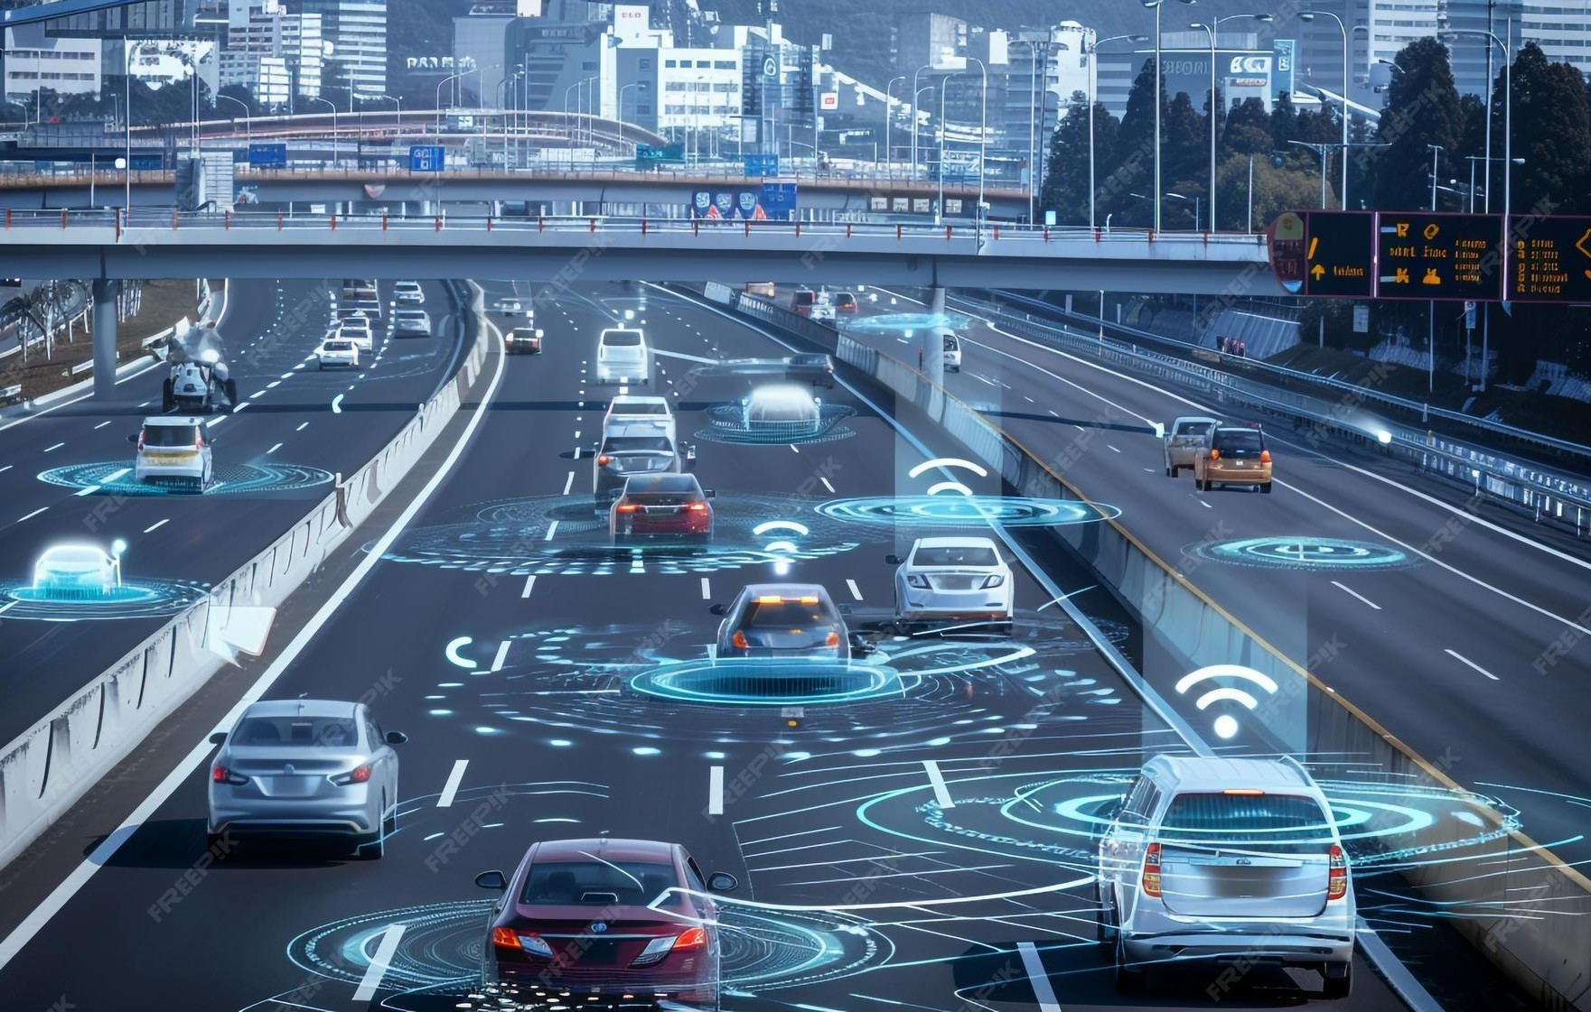
Neuro FleetX AI Powered Urban Fleet and Traﬃc Intelligence
—Dinesh Kumar P

Slide 2
Project:Neuro FleetX AI Powered Urban Fleet and Traﬃc Intelligence
2
NeuroFleetX is an AI-powered fleet management system that controls and enables real-time monitoring of vehicles, drivers, and traffic for efficient and safe transportation.
Key Points
Central platform connecting Admin, Fleet Manager & Drivers
Tracks vehicle status, trip progress, traffic conditions
AI analysis for driver behavior & route optimization
Enhances logistics performance and road safety

Slide 3
Project:NeuroFleetX AI Powered Urban Fleet and Traﬃc Intelligence
3
Administrator Module
Controls and manages the entire fleet system, including users, vehicles, trips, analytics, and configuration through a centralized dashboard.
Fleet Manager Module
Monitors day-to-day fleet operations by tracking traffic, vehicle status, fuel and maintenance needs, and managing alerts for safe and efficient trip coordination.
Driver Module
Executes assigned trips and updates live GPS location, while monitoring vehicle health and receiving AI-powered safety alerts and route guidance.

Slide 4
Project:Neuro FleetX AI Powered Urban Fleet and Traﬃc Intelligence
4
In these project I am working on Driver module
Overview
End-user role responsible for executing assigned trips
Updates live location and trip status
Monitors vehicle health and driving performance

Slide 5
Project:Neuro FleetX AI Powered Urban Fleet and Traﬃc Intelligence
5
Key Responsibilities
View assigned and completed trips
GPS logging / manual location check-in
View vehicle status & maintenance alerts
Receive AI-based behavior score & safety alerts

Slide 6
Project:Neuro FleetX AI Powered Urban Fleet and Traﬃc Intelligence
6
Core Functional Features
Driver Dashboard: My Trips, Alerts, Behavior Score
Trip Execution: Trip details, status, timeline
GPS Logging: Lat/Long/Speed input & check-in
Vehicle Status: Health & service prediction

Slide 7
Thank You…
7

